Slide 1
Natural Language Processing-Part 1
Marziyeh Mousavi
Introduction to datascience
Fall 2024

Slide 2
What is natural language processing?
Natural language processing (NLP) is a field of computer science and a subfield of artificial intelligence that aims to make computers understand human language. NLP uses computational linguistics, which is the study of how language works, and various models based on statistics, machine learning, and deep learning. These technologies allow computers to analyze and process text or voice data, and to grasp their full meaning, including the speaker’s or writer’s intentions and emotions.

Slide 3
What is natural language processing?
NLP powers many applications that use language, such as text translation, voice recognition, text summarization, and chatbots. You may have used some of these applications yourself, such as voice-operated GPS systems, digital assistants, speech-to-text software, and customer service bots. NLP also helps businesses improve their efficiency, productivity, and performance by simplifying complex tasks that involve language.

Slide 4
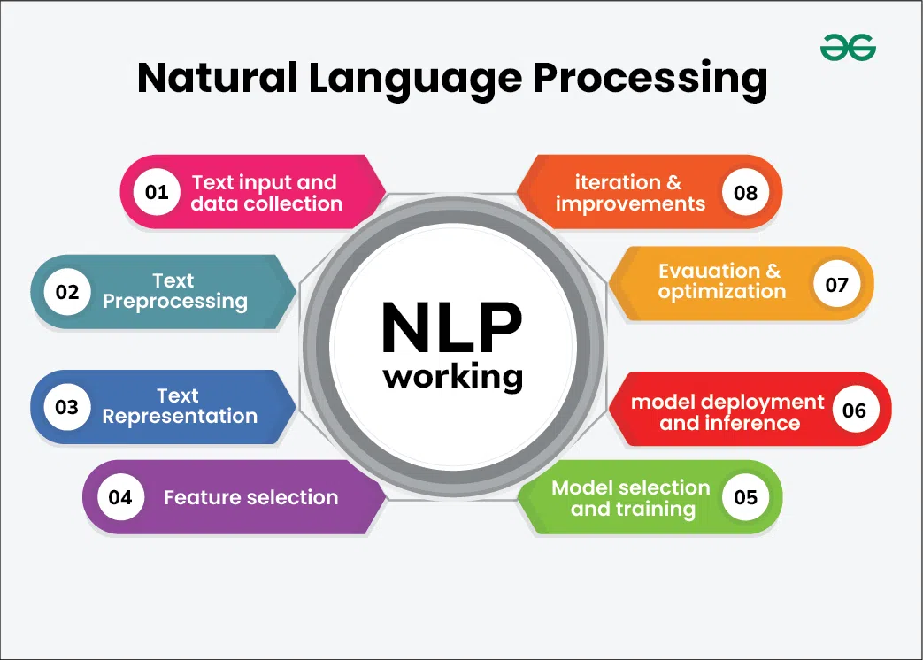
NLP Techniques

Slide 5
Word Clouds
Word Cloud is a data visualization technique used for representing text data in which the size of each word indicates its frequency or importance. Significant textual data points can be highlighted using a word cloud. Word clouds are widely used for analyzing data from social network websites.

Slide 6
Implementation in python
#Importing Libraries
import pandas as pd
import matplotlib.pyplot as plt
%matplotlib inline
from wordcloud import WordCloud
#Importing Dataset
df = pd.read_csv("android-games.csv")

Slide 7
Implementation in python
#Checking the Data
df.head()
#Checking for NaN values
df.isna().sum()
#Removing NaN Values
df.dropna(inplace = True)

Slide 8
Implementation in python
#Creating the text variable
text = " ".join(cat.split()[1] for cat in df.category)
# Creating word_cloud with text as argument in .generate() method
word_cloud = WordCloud(collocations = False, background_color = 'white').generate(text)
# Display the generated Word Cloud
plt.imshow(wordcloud, interpolation='bilinear')
plt.axis("off")
plt.show()

Slide 9

Implementation in python
The output of code is:

Slide 10
Language Models
Language modeling is a foundational concept in the field of Natural Language Processing (NLP), which lies at the intersection of computer science, linguistics, and artificial intelligence. At its core, language modeling involves the prediction of the next word or token in a sequence of words. This seemingly simple task is the basis for a wide range of applications, from text generation and machine translation to sentiment analysis and speech recognition.

Slide 11
N-grams: The Building Blocks of Language Modeling
N-grams are probabilistic language models that estimate the likelihood of a word based on the preceding N-1 words. In other words, they model the conditional probability of a word given its context.

Slide 12
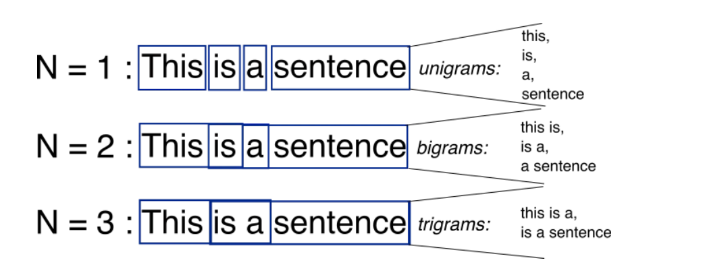
N-grams: The Building Blocks of Language Modeling-The Essence of N-grams
Definition: An N-gram is a contiguous sequence of N items (words, characters, or other tokens) from a given sample of text or speech.

Slide 13
N-grams: The Building Blocks of Language Modeling-The Essence of N-grams
Example: In a bigram (2-gram) model, the probability of a word depends solely on the previous word. So, to predict the third word in the sentence “I love language modeling,” the model only considers the second word, “love.”

Slide 14
Advantages of N-grams
Simplicity: N-grams are intuitive and relatively simple to understand and implement.
Low Memory Usage: They require minimal memory for storage compared to more complex models.

Slide 15
Limitations of N-grams
Limited Context: N-grams have a finite context window, which means they cannot capture long-range dependencies or context beyond the previous N-1 words
Sparsity: As N increases, the number of possible N-grams grows exponentially, leading to sparse data and increased computational demands.

Slide 16
N-grams-example
Let’s work through an example using a mini-corpus of three sentences. We’ll first need to augment each sentence with a special symbol <s> at the beginning of the sentence, to give us the bigram context of the first word. We’ll also need a special end-symbol. </s>
<s> I am Sam </s>
<s> Sam I am </s>
<s> I do not like green eggs and ham </s>

Slide 17

N-grams-example
Here are the calculations for some of the bigram probabilities from this corpus:

Slide 18
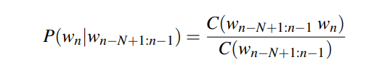
N-grams-example
Here are the calculations for some of the bigram probabilities from this corpus:
For the general case of MLE n-gram parameter estimation:

Slide 19
N-grams-example-relative frequency
The equation estimates the n-gram probability by dividing the observed frequency of a particular sequence by the observed frequency of a prefix. This ratio is called a relative frequency. This use of relative frequencies as a way to estimate probabilities is an example of maximum likelihood estimation or MLE. In MLE, the resulting parameter set maximizes the likelihood of the training set T given the model M (i.e., P(T|M)).

Slide 20
N-grams-example-relative frequency
For example, suppose the word Chinese occurs 400 times in a corpus of a million words like the Brown corpus. What is the probability that a random word selected from some other text of, say, a million words will be the word Chinese? The MLE of its probability is 400 /1000000 or .0004. Now .0004 is not the best possible estimate of the probability of Chinese occurring in all situations; it might turn out that in some other corpus or context Chinese is a very unlikely word. But it is the probability that makes it most likely that Chinese will occur 400 times in a million-word corpus

Slide 21
N-grams-example
We’ll use data from the now-defunct Berkeley Restaurant Project, a dialogue system from the last century that answered questions about a database of restaurants in Berkeley, California (Jurafsky et al., 1994). Here are some text normalized sample user queries (a sample of 9332 sentences is on the website):
can you tell me about any good cantonese restaurants close by
mid priced thai food is what i’m looking for
tell me about chez panisse
can you give me a listing of the kinds of food that are available
i’m looking for a good place to eat breakfast
when is caffe venezia open during the day

Slide 22
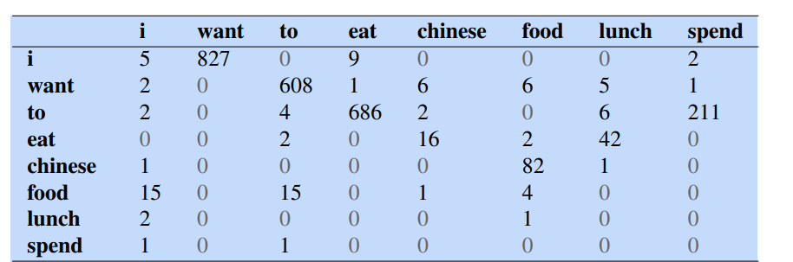
N-grams-example
Table below shows the bigram counts from a piece of a bigram grammar from the Berkeley Restaurant Project. Note that the majority of the values are zero. In fact, we have chosen the sample words to cohere with each other; a matrix selected from a random set of eight words would be even more sparse.

Slide 23
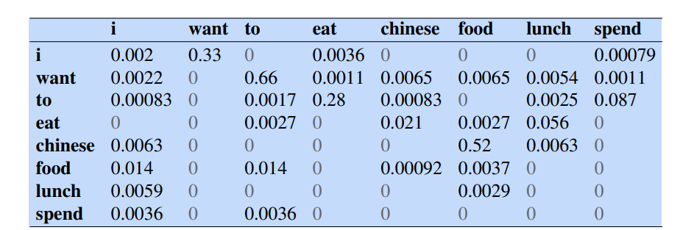
N-grams-example
We normalize the table by dividing each cell in table by the appropriate unigram for its row, taken from the following set of unigram probabilities

Slide 24
N-grams-example
Table below shows the bigram counts from a piece of a bigram grammar from the Berkeley Restaurant Project. Note that the majority of the values are zero. In fact, we have chosen the sample words to cohere with each other; a matrix selected from a random set of eight words would be even more sparse.

Slide 25

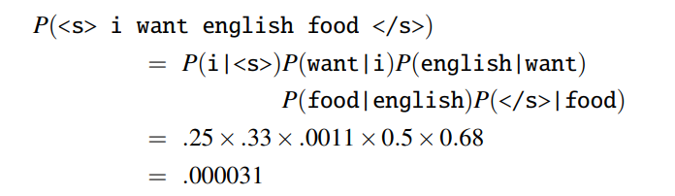
N-grams-example
Here are a few other useful probabilities:
Now we can compute the probability of sentences like I want English food as follows:

Slide 26
Markov Models: Contextual Predictions
Markov models are a step up from N-grams in terms of contextual prediction. They are based on the Markov property, which posits that the probability of a future state depends solely on the current state. In the context of language modeling, this translates to predicting the next word based on the current word, which is known as a first-order Markov model or a Markov chain.

Slide 27
Exploring Markov Models
First-Order Markov Model: In this model, the probability of a word depends only on the preceding word. For example, to predict the third word in a sentence, the model considers only the second word.
Higher-Order Markov Models: These models extend the context window beyond one word. A second-order Markov model considers the probability of a word based on the previous two words, and so on.

Slide 28
Advantages of Markov Models
Improved Contextual Understanding: Markov models capture contextual information better than N-grams, as they can consider more extensive context.

Slide 29
Limitations of Markov Models
Curse of Dimensionality: Higher-order Markov models suffer from the curse of dimensionality. As the context size increases, the number of possible states grows exponentially, making it challenging to estimate accurate probabilities.
Limited Long-Range Dependencies: Even with higher orders, Markov models struggle to capture very long-range dependencies in language.

Slide 30
Neural Language Models: The Power of Deep Learning
Curse of Dimensionality: Higher-order Markov models suffer from the curse of dimensionality. As the context size increases, the number of possible states grows exponentially, making it challenging to estimate accurate probabilities.
Limited Long-Range Dependencies: Even with higher orders, Markov models struggle to capture very long-range dependencies in language.

Slide 31
Unpacking Neural Language Models
Neural language models are characterized by their ability to learn distributed representations of words, often referred to as word embeddings. These embeddings enable neural models to capture complex dependencies and context in text data.

Slide 32
RNNs :
Recurrent Neural Networks (RNNs) and Long Short-Term Memory networks (LSTMs) are both types of neural networks used for sequential data processing, including tasks such as natural language processing (NLP), speech recognition, time series analysis, and more. They are designed to handle data with temporal dependencies, making them suitable for tasks where the order of input data matters.

Slide 33
RNN
Recurrent Neural Network(RNN) is a type of Neural Network where the output from the previous step is fed as input to the current step.
In some cases when it is required to predict the next word of a sentence, the previous words are required and hence there is a need to remember the previous words. Thus RNN came into existence, which solved this issue with the help of a Hidden Layer.

Slide 34
RNN
The main and most important feature of RNN is its Hidden state, which remembers some information about a sequence. The state is also referred to as Memory State since it remembers the previous input to the network.
RNN uses the same weights for each element of the sequence.
RNN are a class of neural networks that is powerful for modeling sequence data such as time series or natural language. Basically, main idea behind this architecture is to use sequential information.

Slide 35
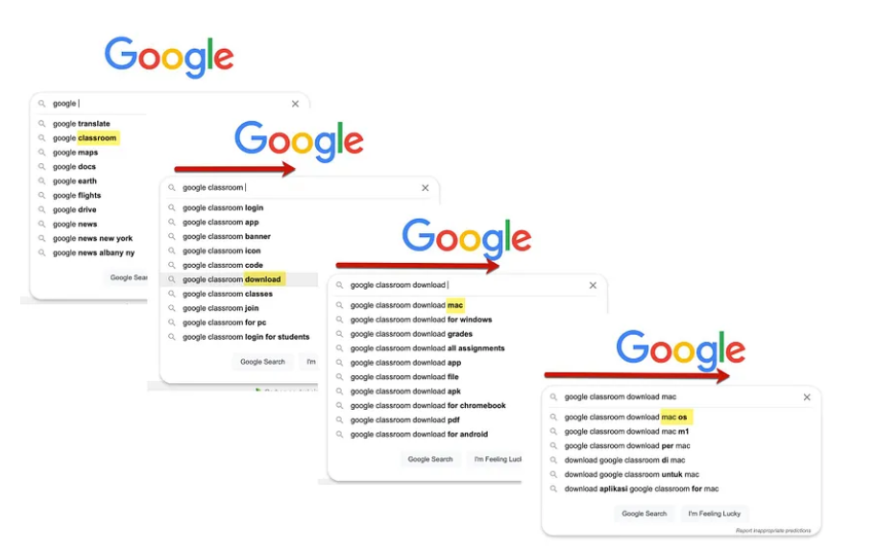
RNN-Google’s autocomplete function
Basically, collection of large volumes of most frequently occurring consecutive words fed into RNN network. It analyze the data by finding the sequence of words occurring frequently and builds a model to predict the next word in the sentence.

Slide 36
RNN
RNNs are different than the classical multi-layer perceptron (MLP) networks because of two main reasons: 1) They take into account what happened previously and 2) they share parameters/weights.

Slide 37
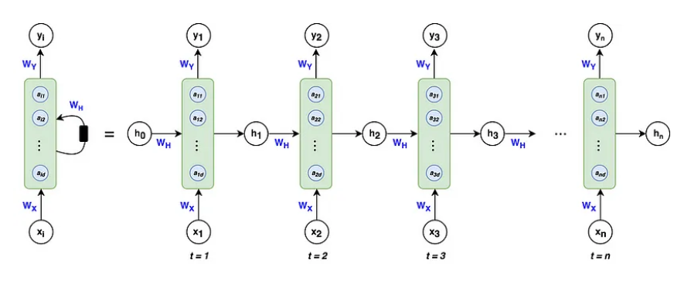
RNN-architecture
Left: Shorthand notation often used for RNNs
Right: Unfolded notation for RNNs

Slide 38
RNN-architecture
The green blocks are called hidden states. The blue circles, defined by the vector a within each block, are called hidden nodes or hidden units where the number of nodes is decided by the hyper-parameter d.

Slide 39
RNN-architecture
Similar to activations in MLPs, think of each green block as an activation function that acts on each blue node. We’ll talk about the calculations within the hidden states in the forward propagation section of this article.

Slide 40
RNN-architecture
vector h — is the output of the hidden state after the activation function has been applied to the hidden nodes. As you can see at time t, the architecture takes into account what happened at t-1 by including the h from the previous hidden state as well as the input x at time t.

Slide 41
RNN-architecture
This allows the network to account for information from previous inputs that are sequentially behind the current input. It’s important to note that the zeroth h vector will always start as a vector of 0’s because the algorithm has no information preceding the first element in the sequence.

Slide 42
RNN-architecture
Matrices Wx, Wy, Wh — are the weights of the RNN architecture which are shared throughout the entire network. The model weights of Wx at t=1 are the exact same as the weights of Wx at t=2 and every other time step.

Slide 43
RNN-architecture
Vector xᵢ — is the input to each hidden state where i=1, 2,…, n for each element in the input sequence

Slide 44
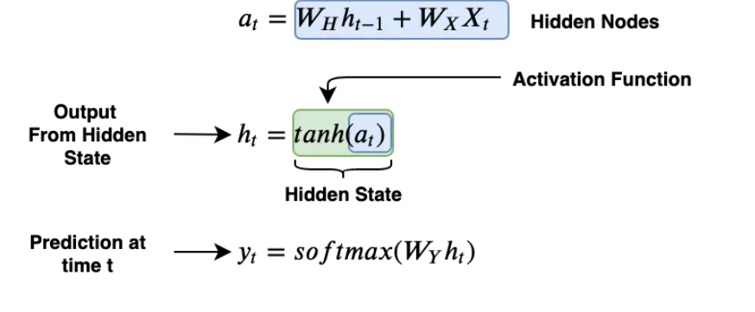
RNN-Equations
The hidden nodes are a concatenation of the previous state’s output weighted by the weight matrix Wh and the input x weighted by the weight matrix Wx.

Slide 45
RNN-Equations
The tanh function is the activation function that we mentioned earlier, symbolized by the green block.

Slide 46
RNN-Equations
The output of the hidden state is the activation function applied to the hidden nodes. To make a prediction, we take the output from the current hidden state and weight it by the weight matrix Wy with a soft max activation.

Slide 47
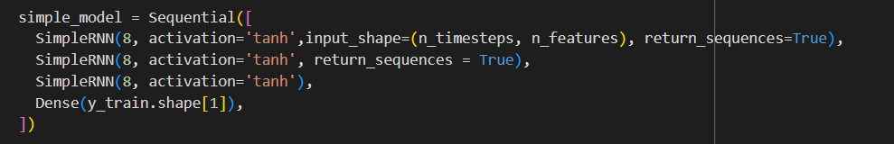
Implementation in python
This is a simple rnn:

